Slide 1
TECH460 Module 6
Implementation Plan

Slide 2
Rubric
Criteria | Total
Include problem statement slide from previous deliverable | 10
Include recommended solution slide from previous deliverable | 10
Work Breakdown Structure | 20
Schedule | 20
Solution validation | 30
Solution evaluation and continuous improvement | 30
Legal, ethical and cultural considerations | 30
Total | 150

Slide 3
Problem Statement
Support Ray-Ban and Meta’s addition of an augmented reality visual layer on their flagship devices under the Smart Glasses line through the design of a mobile interface to augment the current selling points of the device
Display visual information related to AI search
Provide visual feedback to partner with audio feedback for major features like calling, AI search, capture, etc.
Allow user to disable through the use of an audio command or touchpad

Slide 4
Recommended Solution
Micro Projection
Justification
Faster development time
Technology is actually available and easily developed in
Battery life will not be impacted as much as the other options
Multiple projectors can be used to obtain the desired resolution where needed

Slide 5
Work Breakdown Structure
Analysis
Draft specifications
Review and approval
Basic Display Design
Complete UX design
Display Development
Design internal software
Establish design rules for current and new features
Integrate with current features
Display adaption (fitting it to frames)
Finalize frame selection
Design hardware to suit display
Finalize minimum sizing of frames + lenses
Design & Function Validation
Testing display use in and out of frame
Testing all current features using display
Final Validation of product
Beta testing with finalized frames
Testing current + proposed features for day 0 launch
Deployment
Product dispersal to public testers
Product announcement
Deploy to online sales platform

Slide 6
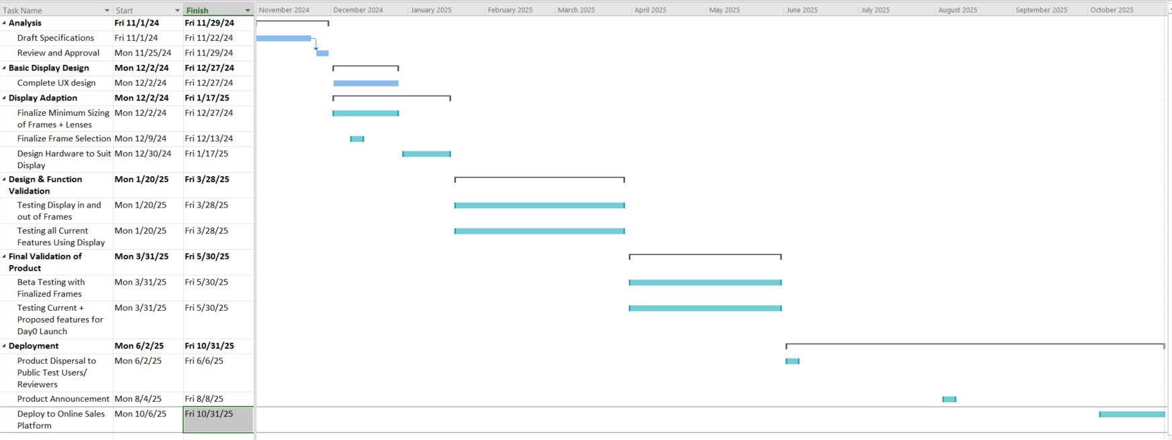
Schedule

Slide 7
Validation
Display will be tested per lens, individually as well as in a dual display to give an AR feel
Existing functionality will be tested with and without use of display
Data transfer and safety will be tested to ensure security
Alpha and beta testing will be completed internally before announcing product

Slide 8
Evaluation and Continuous Improvement
Beta testing of the device will continue with cutting edge development internally alongside development and improvement of functionality
Internal and external bug tracking
Data monitoring using the AI model will be conducted as needed
Storage will be adjusted based on size of user pool as needed
Integration testing will be conducted based on newer OS versions and older hardware

Slide 9
Legal, Ethical and Cultural Considerations
Legal
Recoding or transmitting images or sound of strangers/ those that did not give consent
Health considerations – having a display and the potential of reflective lasers as part of the display
Ethical
AI and LLMs are a sensitive subject to some users
Continual usage and the possibility of addiction
Cultural
Addition and over-reliance on electronic aids

